Slide 1
GESTÃO DE REDES / NETWORK MANAGEMENT Notas complementares / Complementary notes
NETCONF + YANG RESTCONF

Slide 2
Introduction
Networks Operators complained that configuration management was not being addressed by IETF! (RFC3535)
But, can’t we do it with existing management technology? Do we need a new one?
SNMP / SMIv2 / MIBs
COPS-PR /SPPI /PIBs
SIM / MOP / UML / PCIM
CLI / TELNET / SSH
HTTP / HTML
XML

Slide 3
Introduction
What about SNMP?
SNMP / SMI / MIBs
Works very well for device monitoring
The stateless nature of SNMP is useful for statistical and status polling.
Core MIBs implemented everywhere!
Many proprietary MIBs available & supported
Important for event correlation, alarm detection, and root cause analysis
Too little deployment of writable MIB modules! (devices are not fully configurable by SNMP)
The transactional model and the protocol constraints make it more complex to implement MIBs
Scaling problems with regard to the number of objects in a device
Semantic mismatch between the task-oriented view and data-centric view (no high level proc.)
Standard MIB modules often lack writable MIB objects which can be used for configuration
SNMP requires applications to be useful: Designed as a programmatic interface between management applications and devices.

Slide 4
Introduction
What about CLI / TELNET / SSH ?
CLI / TELNET / SSH
A saved sequence of textual commands can easily be replayed
It is natural to use the same interface users already use and same abstractions for automating configuration change
Command line interface (CLI) does not require any special purpose applications
CLI are task-oriented by nature…
Most command line interfaces provide context sensitive help (reduced learning curve)
Some CLI interfaces lack a common data model (different behavior between vendors)
Command line interface is primarily targeted to humans (who can adjust to changes easily)
CLI lack of proper version control for the syntax and the semantic (difficult to maintain)
Not efficient in multi-vendor environments
Access control is often ad-hoc and insufficient
It is still a common practice to use TELNET/SSH to access and configure devices using their CLI

Slide 5
Introduction
What about HTTP / HTML ?
HTTP / HTML
Embedded web servers for configuration are end-user friendly and solution oriented
Suitable for configuring consumer devices by inexperienced users
No need for specialized applications (only a web browser is required)
Embedded web servers are management application hostile (difficult to use by programs)
Replay of configuration is often problematic (different versions of same device may use different interface)
The access control facilities are often ad-hoc and sometimes insufficient.
Many devices have an embedded web server which can be used to configure the device and to obtain status information. Access and configuration through HTTP/HTML are common.

Slide 6
Requirements
Network Operators identified Requirements (RFC3535):
Easy to use (a key requirement!)
Clear distinction between configuration data, operational state and statistics (which parameters were really administratively configured?)
To fetch separately configuration data, operational state data, and statistics…
Enable operators to concentrate on the configuration of the entire network as a whole, rather than individual devices
Support configuration transactions across a number of devices…
Operational change from config A to config B with minimal state changes. Minimize the possible impact of config changes.
Need standards for pulling and pushing configurations from devices
It must be easy to do consistency checks of configurations over time, per link…
(…)

Slide 7
Requirements
(… )
Network wide configurations are typically stored in central master databases (…) standardize the common parts of these network wide configuration database schemas
Use text tools, like diff or version control (…) devices should not reorder data
A role-based access control model and the principle of least privilege…
To do consistency checks of access control lists across devices
Distinguish between the distribution of configurations and the activation of a certain configuration. Devices should be able to hold multiple configurations
it is a requirement to support both data-oriented and task-oriented access control

Slide 8
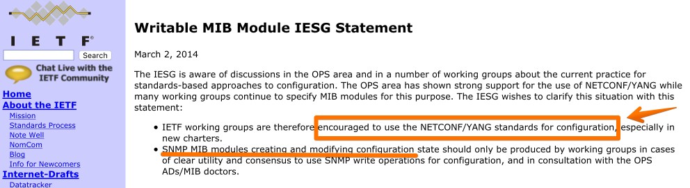
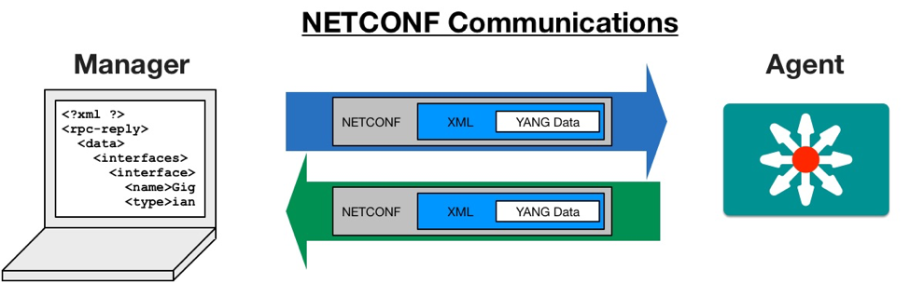
NETCONF / YANG
Image from https://medium.com/@k.okasha/network-automation-and-the-rise-of-netconf-e96cc33fe28

Slide 9
NETCONF / YANG
NETCONF: Network Configuration Protocol
YANG: Yet Another Next Generation
This protocol defines a simple mechanism where network management applications, acting as clients, can invoke operations on the devices, which act as servers.
Configuration data information can be retrieved, and new configuration data can be uploaded and manipulated.
NETCONF specification [RFC4741] defines a small set of operations
Avoid making any requirements on the data carried on those operations → Data Agnostic
YANG is a data modeling language used to model configuration and state data manipulated by NETCONF [RFC6020]
Allowing both standard and proprietary data models to be published (human readable)
YANG allows a modeler to create a data model, to define the organization of the data in that model, and to define constraints on that data.

Slide 10
NETCONF
Different paradigm:
task-oriented approach → not data-centric as in SNMP
Over a connection-oriented transport service (usually SSH)
Includes mechanisms for controlling configuration datastores
A NETCONF session is the logical connection between a network administrator or network configuration application and a network device.
All NETCONF operations are carried out within a session
The NETCONF server is required to authenticate the entity requesting a session before processing any request
NETCONF messages MUST be well-formed XML, encoded in UTF-8
XML-based remote procedure call (RPC) mechanism

Slide 11
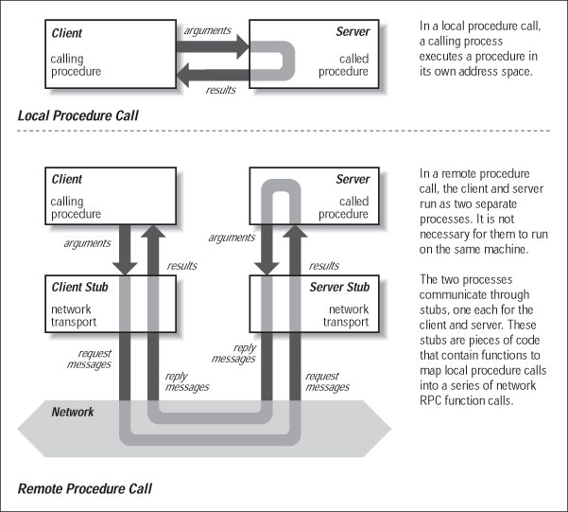
NETCONF: XML-based RPC
What is RPC (Remote Procedure Call)?

Slide 12
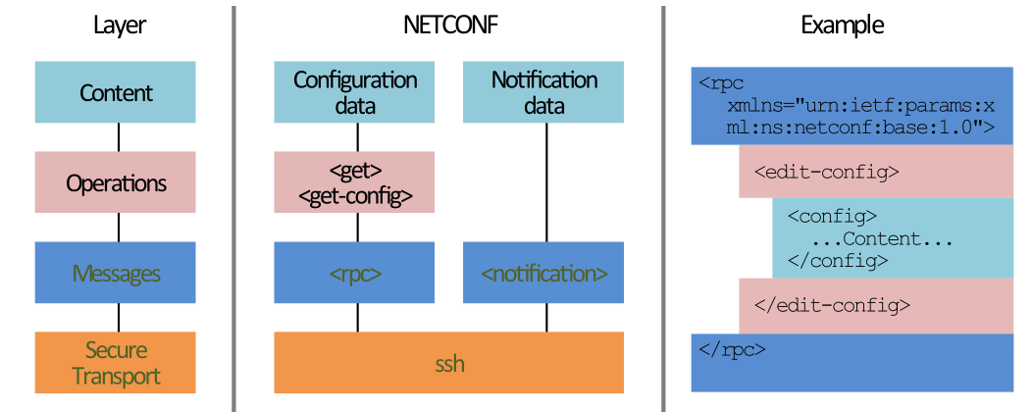
NETCONF: Layers
Notice the colors: they show relation between the layers and the encapsulation of data in PDUs
Image from https://www.ietf.org/slides/slides-edu-network-configuration-with-netconf-00.pdf

Slide 13
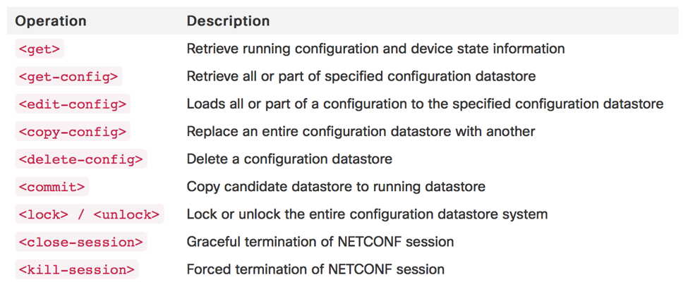
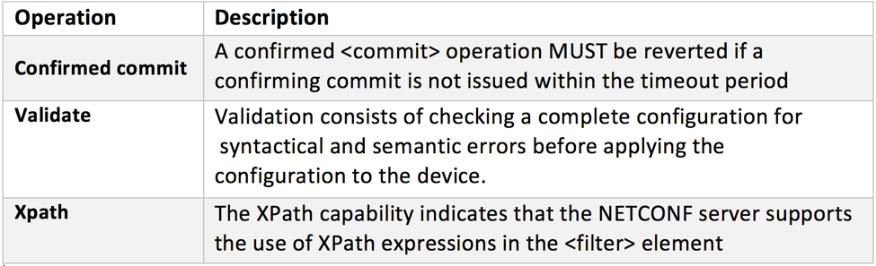
NETCONF: Operations
The NETCONF standard (RFC 4741) defined the following operations that can be executed against the different data store
RFC6241 updated with some variants like a confirmed commit and a validate:

Slide 14
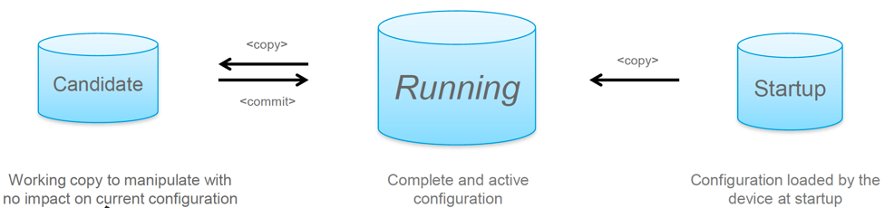
NETCONF: Configuration Databases
There may exist several configuration databases on devices
Not all devices implement them all (not required)
NETCONF operations are targeted to lock – retrieve – edit – save – copy – unlock configs on any of those data stores
Image from https://medium.com/@k.okasha/network-automation-and-the-rise-of-netconf-e96cc33fe28

Slide 15
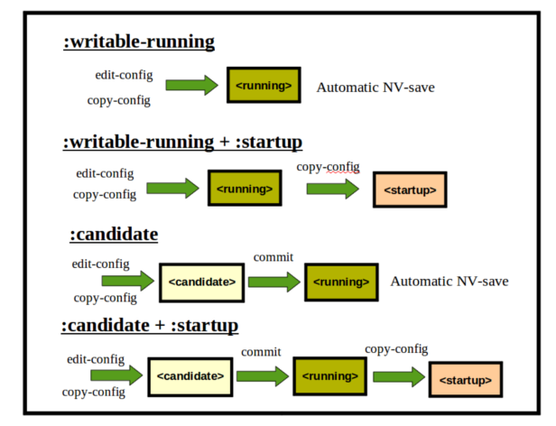
NETCONF: Configuration Databases
Only one Configuration:
<RUNNING>
Two Configurations:
<RUNNING>
<STARTUP>
Two Configurations:
<CANDIDATE>
<RUNNING>
All config DBs!
Image from http://www.netconfcentral.org/netconf_docs

Slide 16
NETCONF: Configuration Databases
New model recently proposed (RFC 8342, March 2018)
<candidate>
(ct, rw)
<startup>
(ct, rw)
<running>
(ct, rw)
// config. transformations, e.g. removal of // nodes marked “inactive”, expansion of // templates…
<intended>
(ct, ro)
Subject to validation //
Learned configuration
System configuration
System configuration
Dynamic Configuration Datastores
<operational>
(ct + cf, ro)
System State

Slide 17
NETCONF & YANG
The NETCONF client and server are driven by the content of YANG modules
Server (device)
configuration
YANG Models
state data
metadata
notifications
operations
Client (App)
<rpc>
NETCONF Engine
<rpc-reply>
config database
system software component

Slide 18
YANG version 1.1
YANG is a language originally designed to model data for the NETCONF protocol (RFC 7950, august 2016)
Standard Modules and Proprietary Models: define configuration data, RPC, notifications
Defines hierarchies of data that can be used in operations (configuration, state data, etc.)
Data organized as a tree, where every node has a name and either a value or a set of child nodes;
Modules and Submodules
Top-level
Leaf Node
contains simple data, like integer or string
Leaf-List Nodes
defines a sequence of values of a type
Container Nodes
used to group related nodes in a subtree
List Nodes
defines a sequence of list entries

Slide 19
YANG version 1.1
example-system model
XML
<?xml version="1.0" encoding="UTF-8"?>
<module name="example-system"
xmlns="urn:ietf:params:xml:ns:yang:yin:1"
xmlns:sys="urn:example:system">
<yang-version value="1.1"/>
<namespace uri="urn:example:system"/>
<prefix value="sys"/>
<organization>
<text>Example Inc.</text>
</organization>
<contact>
<text>joe@example.com</text>
</contact>
<description>
<text>The module for entities implementing the Example system.</text>
</description>
<revision date="2007-06-09">
<description>
<text>Initial revision.</text>
</description>
</revision>
…
YANG
module example-system {
yang-version 1.1;
namespace "urn:example:system";
prefix "sys";
organization "Example Inc.";
contact "joe@example.com";
description
"The module for entities implementing the Example system.";
revision 2007-06-09 {
description "Initial revision.";
}
………
}
$ pyang –f yin example-system.yang

Slide 20
YANG version 1.1
Leaf Node example
Leaf-List Node example
YANG
XML
leaf host-name {
type string;
description
"Hostname for this system.";
}
<host-name>my.example.com</host-name>
Leaf node has:
- one value; no children; one instance
YANG
XML
leaf-list domain-search {
type string;
description
"List of domain names to search.";
}
<domain-search>high.example.com</domain-search>
<domain-search>low.example.com</domain-search>
<domain-search>every.example.com</domain-search>
Leaf-List node has:
- one value; no children; multiple instances;

Slide 21
YANG version 1.1
Container Node example
YANG
container system {
container login {
leaf message {
type string;
description
"Message given at start of login session.";
}
}
XML
<system>
<login>
<message>Good morning</message>
</login>
</system>
Container node has:
- no value; only child nodes; any number of child nodes of any type;

Slide 22
YANG version 1.1
List Node example
YANG
XML
list user {
key "name";
leaf name {
type string;
}
leaf full-name {
type string;
}
leaf class {
type string;
}
}
<user>
<name>glocks</name>
<full-name>Goldie Locks</full-name>
<class>intruder</class>
</user>
<user>
<name>snowey</name>
<full-name>Snow White</full-name>
<class>free-loader</class>
</user>
<user>
<name>rzell</name>
<full-name>Rapun Zell</full-name>
<class>tower</class>
</user>
List node has:
- each entry is like a container identified by key; defines multiple key leafs; any number of child nodes of any type;

Slide 23
YANG version 1.1
rpc activate-software-image {
input {
leaf image-name {
type string;
}
}
output {
leaf status {
type string;
}
}
}
RPC definition
Example 1:
An RPC operation with one input parameter and one output result
YANG
<rpc message-id="101"
xmlns="urn:ietf:params:xml:ns:netconf:base:1.0">
<activate-software-image xmlns="http://example.com/system">
<image-name>example-fw-2.3</image-name>
</activate-software-image>
</rpc>
<rpc-reply message-id="101"
xmlns="urn:ietf:params:xml:ns:netconf:base:1.0">
<status xmlns="http://example.com/system">
The image example-fw-2.3 is being installed.
</status>
</rpc-reply>
XML

Slide 24
YANG version 1.1
list interface {
key "name";
leaf name {
type string;
}
action ping {
input {
leaf destination {
type inet:ip-address;
}
}
output {
leaf packet-loss {
type uint8;
}
}
}
}
RPC definition
Example 2:
An RPC operation tied to a list!
<rpc message-id="102"
xmlns="urn:ietf:params:xml:ns:netconf:base:1.0">
<action xmlns="urn:ietf:params:xml:ns:yang:1">
<interface xmlns="http://example.com/system">
<name>eth1</name>
<ping>
<destination>192.0.2.1</destination>
</ping>
</interface>
</action>
</rpc>
<rpc-reply message-id="102"
xmlns="urn:ietf:params:xml:ns:netconf:base:1.0"
xmlns:sys="http://example.com/system">
<sys:packet-loss>60</sys:packet-loss>
</rpc-reply>
YANG
XML

Slide 25
YANG version 1.1
Notification example
YANG
notification link-failure {
description
"A link failure has been detected.";
leaf if-name {
type leafref {
path "/interface/name";
}
}
leaf if-admin-status {
type admin-status;
}
leaf if-oper-status {
type oper-status;
}
}
XML
<notification
xmlns="urn:ietf:params:netconf:capability:notification:1.0">
<eventTime>2007-09-01T10:00:00Z</eventTime>
<link-failure xmlns="urn:example:system">
<if-name>so-1/2/3.0</if-name>
<if-admin-status>up</if-admin-status>
<if-oper-status>down</if-oper-status>
</link-failure>
</notification>

Slide 26
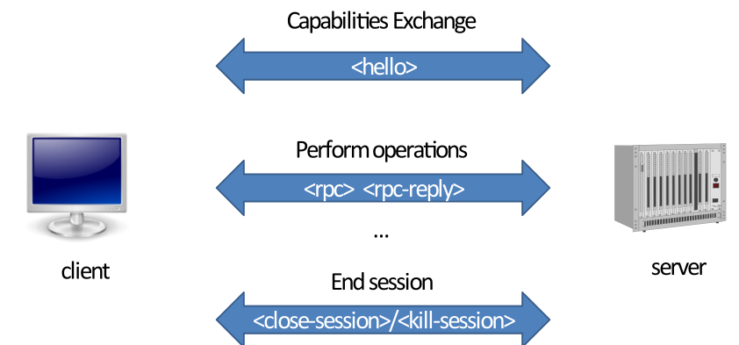
NETCONF: Example workflow
Client: open an SSH connection to port 830 (NETCONF PORT) or to any other port and request NETCONF subsystem
Client: say “Hello” and provide supported capabilities
Server: answers with its own supported capabilities
Client: call remote procedures…
Client/Server: close the session
Image from https://www.ietf.org/slides/slides-edu-network-configuration-with-netconf-00.pdf

Slide 27
NETCONF simple example
STEP 1: <hello>
<?xml version="1.0" encoding="UTF-8"?>
<hello xmlns="urn:ietf:params:xml:ns:netconf:base:1.1">
<capabilities>
<capability>urn:ietf:params:netconf:base:1.1</capability>
</capabilities>
</hello>
C
S
<?xml version="1.0" encoding="UTF-8"?>
<hello xmlns="urn:ietf:params:xml:ns:netconf:base:1.1">
<capabilities>
<capability>urn:ietf:params:netconf:base:1.1</capability>
<capability> urn:ietf:params:netconf:capability:writable-running:1.0 </capability>
<capability>urn:ietf:params:netconf:capability:candidate:1.0 </capability>
</capabilities>
<session-id>5</session-id>
</hello>
C
S

Slide 28
NETCONF simple example
STEP 2: <get> all model data from device
<rpc message-id="102” xmlns="urn:ietf:params:xml:ns:netconf:base:1.0">
<get/>
</rpc>
C
S
<rpc-reply message-id="102” xmlns="urn:ietf:params:xml:ns:netconf:base:1.0">
<data>
<!-- ... entire set of data returned ... -->
</data>
</rpc-reply>
C
S

Slide 29
NETCONF simple example
STEP 3: <get> filter model data from device
<rpc message-id="103” xmlns="urn:ietf:params:xml:ns:netconf:base:1.0">
<get>
<filter type="subtree">
<t:top xmlns:t="http://example.com/schema/1.2/stats">
<t:interfaces>
<t:interface t:ifName="eth0"/>
</t:interfaces>
</t:top>
</filter>
</get>
</rpc>
C
S
<rpc-reply message-id="103"
xmlns="urn:ietf:params:xml:ns:netconf:base:1.0">
<data>
<t:top xmlns:t="http://example.com/schema/1.2/stats">
<t:interfaces>
<t:interface t:ifName="eth0">
<t:ifInOctets>45621</t:ifInOctets>
<t:ifOutOctets>774344</t:ifOutOctets>
</t:interface>
</t:interfaces>
</t:top>
</data>
</rpc-reply>
C
S

Slide 30
NETCONF simple example
STEP 4: <close-session>
<rpc message-id="104"
xmlns="urn:ietf:params:xml:ns:netconf:base:1.0">
<close-session/>
</rpc>
C
S
<rpc-reply message-id="104"
xmlns="urn:ietf:params:xml:ns:netconf:base:1.0">
<ok/>
</rpc-reply>
C
S

Slide 31
NETCONF Advanced example
Example1: configuration update against a single device
Acquiring the configuration lock.
Checkpointing the running configuration.
Loading and validating the incoming configuration.
Changing the running configuration.
Testing the new configuration.
Making the change permanent (if desired).
Releasing the configuration lock.

Slide 32
NETCONF Advanced example
Step 1: A lock should be acquired to prevent simultaneous updates from multiple sources
If :candidate capability is available, the candidate configuration should be locked
<rpc message-id="101"
xmlns="urn:ietf:params:xml:ns:netconf:base:1.0">
<lock>
<target>
<running/>
</target>
</lock>
</rpc>
<rpc message-id="101”
xmlns="urn:ietf:params:xml:ns:netconf:base:1.0">
<lock>
<target>
<candidate/>
</target>
</lock>
</rpc>

Slide 33
NETCONF Advanced example
Step 2: The running configuration can be saved into a local file as a checkpoint
To restore the checkpoint file, reverse the <source> and <target> parameters
<rpc message-id="101”
xmlns="urn:ietf:params:xml:ns:netconf:base:1.0">
<copy-config>
<target>
<url>file://checkpoint.conf</url>
</target>
<source>
<running/>
</source>
</copy-config>
</rpc>

Slide 34
NETCONF Advanced example
Step 3 If the :candidate capability is supported, the configuration can be loaded onto the device without impacting the running system
If the device supports the :validate:1.1 capability, validate it:
<rpc message-id="101”
xmlns="urn:ietf:params:xml:ns:netconf:base:1.0">
<edit-config>
<target>
<candidate/>
</target>
<config>
<!-- place incoming configuration changes here -->
</config>
</edit-config>
</rpc>
<rpc message-id="101”
xmlns="urn:ietf:params:xml:ns:netconf:base:1.0">
<validate>
<source>
<candidate/>
</source>
</validate>
</rpc>

Slide 35
NETCONF Advanced example
Step 4: Changing the Running Configuration
If the device supports the :candidate, commit the changes to running
If not, the configuration change is loaded directly into running
<rpc message-id="101”
xmlns="urn:ietf:params:xml:ns:netconf:base:1.0">
<commit>
<confirmed/>
<confirm-timeout>120</confirm-timeout>
</commit>
</rpc>
<rpc message-id="101”
xmlns="urn:ietf:params:xml:ns:netconf:base:1.0">
<edit-config>
<target>
<running/>
</target>
<config>
<!-- place incoming configuration changes here -->
</config>
</edit-config>
</rpc>

Slide 36
NETCONF Advanced example
Step 5: Testing the New Configuration
To gain confidence, the application can run tests of the operational state of the device.
Step 6: Making the Change Permanent
If the device supports the :startup capability, make changes permanent
If device supports :candidate, and a confirmed commit was request, the confirming commit must be send before timeout or it will be reverted! (Why?)
<rpc message-id="101”
xmlns="urn:ietf:params:xml:ns:netconf:base:1.0">
<copy-config>
<target>
<startup/>
</target>
<source>
<running/>
</source>
</copy-config>
</rpc>
<rpc message-id="101”
xmlns="urn:ietf:params:xml:ns:netconf:base:1.0">
<commit/>
</rpc>

Slide 37
NETCONF Advanced example
Step 7: Releasing the Configuration Lock
If the :candidate capability is supported, the unlock operation is performed on the candidate…
<rpc message-id="101”
xmlns="urn:ietf:params:xml:ns:netconf:base:1.0">
<unlock>
<target>
<running/>
</target>
</unlock>
</rpc>
<rpc message-id="101”
xmlns="urn:ietf:params:xml:ns:netconf:base:1.0">
<unlock>
<target>
<candidate/>
</target>
</unlock>
</rpc>

Slide 38
NETCONF Advanced example
Example 2: Operations on Multiple Devices
Transaction semantics is required!
NETCONF protocol contains sufficient primitives upon which transaction-oriented operations can be built
Complete transactional support among all devices is prohibitively expensive!
But… we may reduce the size and number of windows for failure scenarios!
Classes of multidevice operation:
the operation can fail on individual devices without requiring all devices to revert to their original state!
→ Repeat the operation later… on that device only
the operation should complete on all devices or be fully reversed.
→ The same steps used in single-device operations are used, but are performed in parallel across all devices! If any step fails, the previous configurations can be restored!

Slide 39
RESTCONF
RESTCONF
RESTCONF uses HTTP methods to implement the equivalent of NETCONF operations, enabling basic CRUD operations on a hierarchy of conceptual resources.
Create (POST), Read (GET), Update (PUT), Delete (DELETE)
RESTCONF is not intended to replace NETCONF, but rather to provide an HTTP interface
The HTTP POST, PUT, PATCH, and DELETE methods are used to edit data resources represented by YANG data model
RESTCONF does not need to mirror the full functionality of the NETCONF protocol

Slide 40
RESTCONF
Coexistence with NETCONF
t is possible that locks are in use on a RESTCONF server, even though RESTCONF cannot manipulate locks. In such a case, the RESTCONF protocol will not be granted write access to data resources within a datastore.
Network Device
Web App
RESTCONF
Datastore
Client (App)
NETCONF

Slide 41
RESTCONF Example
Retrieve the Top-Level API Resource
GET /.well-known/host-meta HTTP/1.1
Host: example.com
Accept: application/xrd+xml
HTTP/1.1 200 OK
Content-Type: application/xrd+xml
Content-Length: nnn
<XRD xmlns='http://docs.oasis-open.org/ns/xri/xrd-1.0’>
<Link rel='restconf' href='/restconf’/>
</XRD>

Slide 42
RESTCONF Example
The client may then retrieve the top-level API resource
In JSON or XML…
GET /restconf HTTP/1.1
Host: example.com
Accept: application/yang-data+json
HTTP/1.1 200 OK
Date: Thu, 26 Jan 2017 20:56:30 GMT
Server: example-server
Content-Type: application/yang-data+json
{
"ietf-restconf:restconf" : {
"data" : {},
"operations" : {},
"yang-library-version" : "2016-06-21”
}
}

Slide 43
RESTCONF Example
Retrieve the Server Capability Information
GET /restconf/data/ietf-restconf-monitoring:restconf-state/capabilities HTTP/1.1
Host: example.com
Accept: application/yang-data+xml
HTTP/1.1 200 OK
Date: Thu, 26 Jan 2017 20:56:30 GMT
Server: example-server
Cache-Control: no-cache
Last-Modified: Thu, 26 Jan 2017 16:00:14 GMT
Content-Type: application/yang-data+xml
<capabilities xmlns="urn:ietf:params:xml:ns:yang:ietf-restconf-monitoring">
<capability>\
urn:ietf:params:restconf:capability:defaults:1.0?\
basic-mode=explicit\
</capability>
….
</capabilities>

Slide 44
References
http://www.netconfcentral.org/
https://ripe68.ripe.net/presentations/181-NETCONF-YANG-tutorial-43.pdf
https://datatracker.ietf.org/wg/netconf/documents/
https://www.cisco.com/c/en/us/support/docs/storage-networking/management/200933-YANG-NETCONF-Configuration-Validation.html
http://www.yumaworks.com/support/download-yumapro-client/
https://tools.ietf.org/html/rfc3535
https://tools.ietf.org/html/rfc6241
https://tools.ietf.org/html/rfc6020
https://tools.ietf.org/html/rfc6244
https://tools.ietf.org/html/rfc8040
https://www.ietf.org/slides/slides-edu-network-configuration-with-netconf-00.pdf
https://medium.com/@k.okasha/network-automation-and-the-rise-of-netconf-e96cc33fe28

